Slide 1
Prediction of Water Quality Index (WQI) Using Machine Learning Algorithms
Ayse B Sengul, PhD
Springboard Data Science Capstone Project
April 26, 2024

Slide 2
Problem Statement
Global freshwater demand increases with population and economic growth.
This strains water quality, necessitating effective monitoring methods.
WQI simplifies water quality assessment but has limitations.
ML offers a promising solution for accurate WQI prediction.
This study aims to develop ML-based techniques for efficient WQI prediction.

Slide 3
Data Overview
Source:
City of Cape Coral Water Quality data from various monitoring stations.
Monthly sampling.
1986 – 2022.
Size:
18148 rows and 48 columns.
Key Features:
Temperature, dissolved oxygen, conductivity, dissolved oxygen, pH, nitrite, nitrate, total nitrogen, total phosphorus, total suspended solids, biological oxygen demand, chlorophyll and turbidity.
*https://capecoral-capegis.opendata.arcgis.com/datasets/b0579ba7aa1145e090c3a74e295564df_1/explore

Slide 4
Flowchart of the WQI Prediction
Water Quality
Data
Data Preprocessing
Data Splitting
Feature Scaling
Cleaning
Training Set
Training Set
Power Transformation
Feature Engineering
Data Formatting
80%
20%
MinMaxScaler
Model Evaluation
Model Training
Best Performing Model
R-squared
Model Selection
Cross Validation
Hyperparameter Tuning (GridSearchCV)
MSE
Linear, Lasso, Ridge, RF, XGBoost
3 – 5 – 7 – 10 fold
RF
XGBoost
MAE
RF: Random Forest, MSE: mean squared error, MAE: mean absolute error

Slide 5
Data Wrangling
Select and rename columns for clarity.
Convert data types (e.g., float for 'TP', datetime for 'Date').
Focus on river water samples.
Handle missing data by removing high-missing columns (‘Chl’).
Correct zero ('Temp (°C)', 'pH') and erroneous values ('TN', 'TP', 'Turbidity').
Impute NaN values with the median.
Compute WQI and classify into water quality classes.

Slide 6
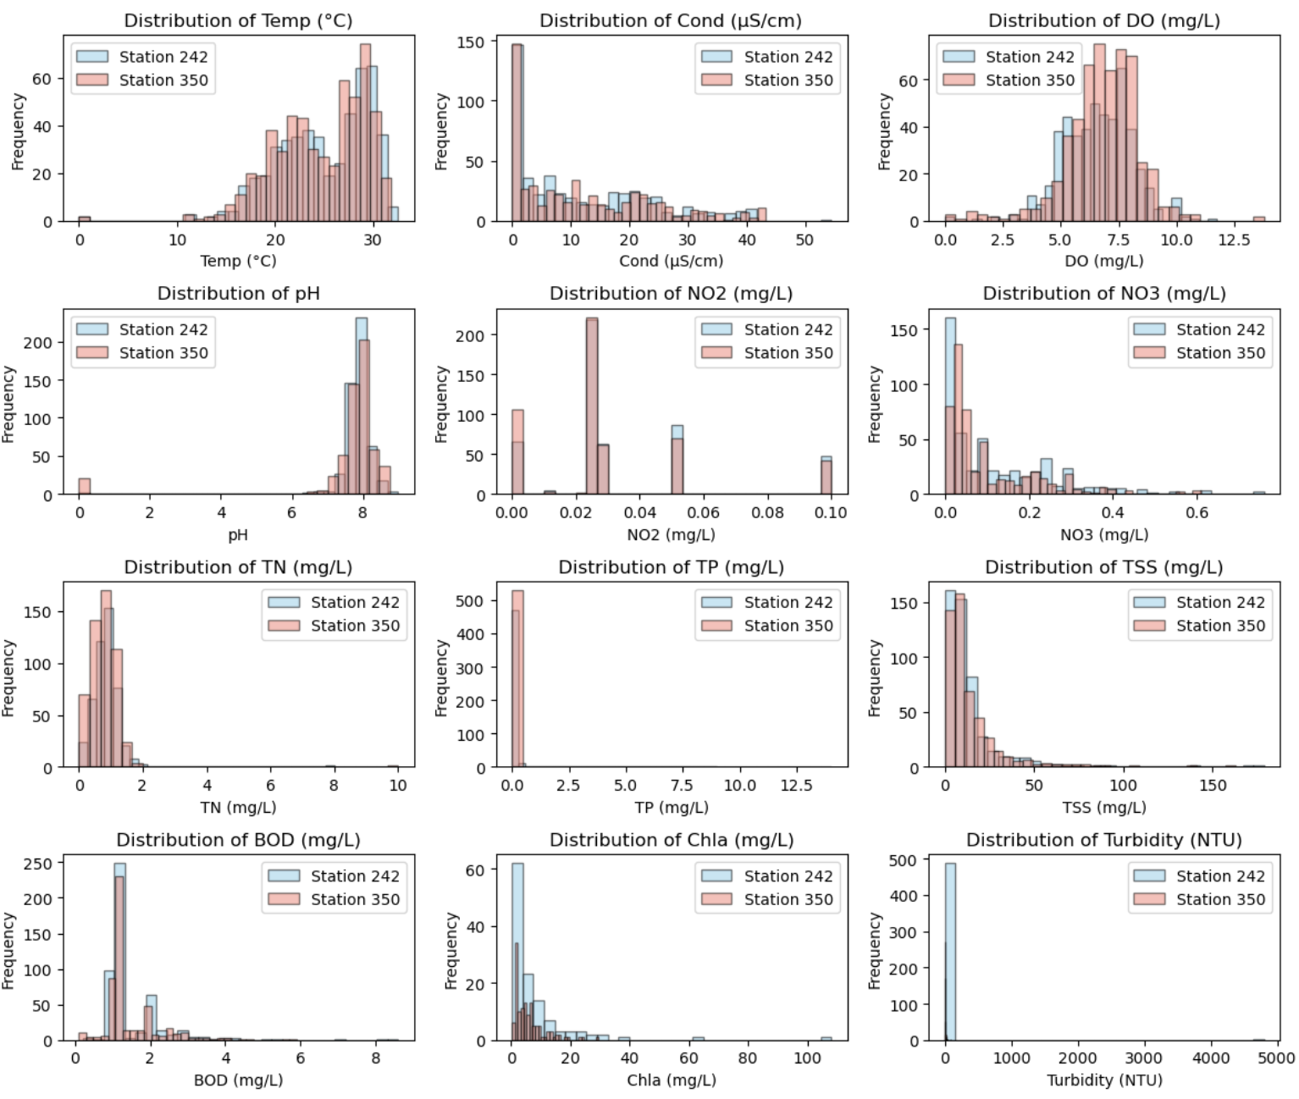
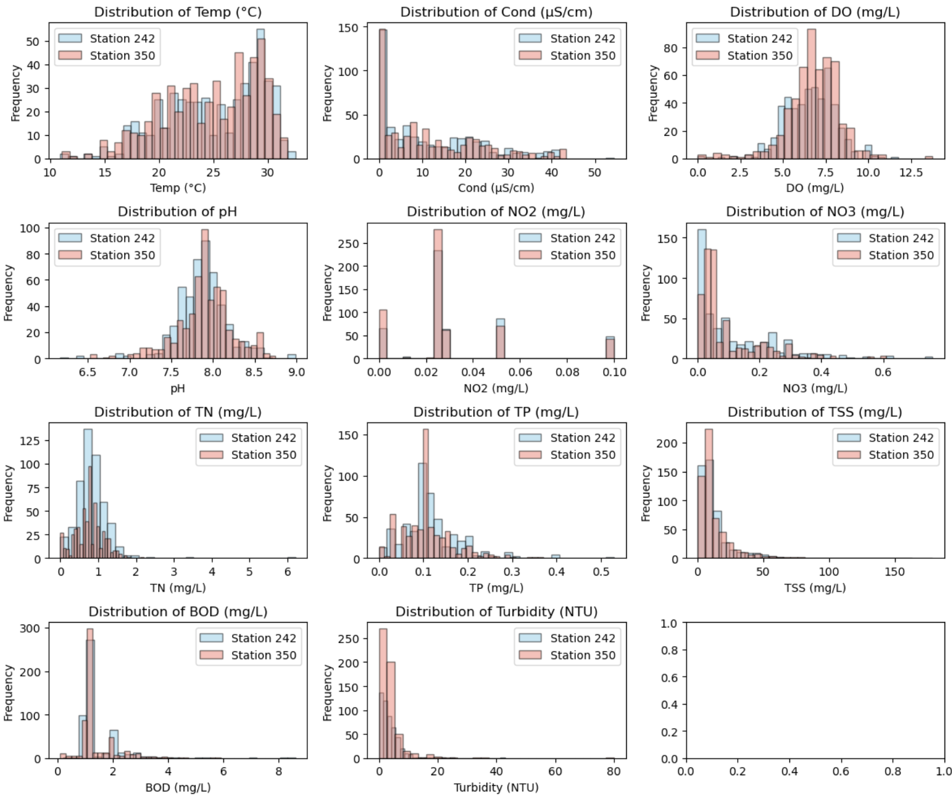
Data Wrangling
Figure 1. Distribution of data before processing.
Figure 2. Distribution of data after processing.

Slide 7
Exploratory Data Analysis (EDA)
Removed duplicates, resulting in 1025 rows and 14 columns.
Identified and analyzed outliers for potential data errors.
Examined skewed (NO3, TN, TP, TSS, BOD, Turbidity) and multimodal distributions in features (NO2).

Slide 8
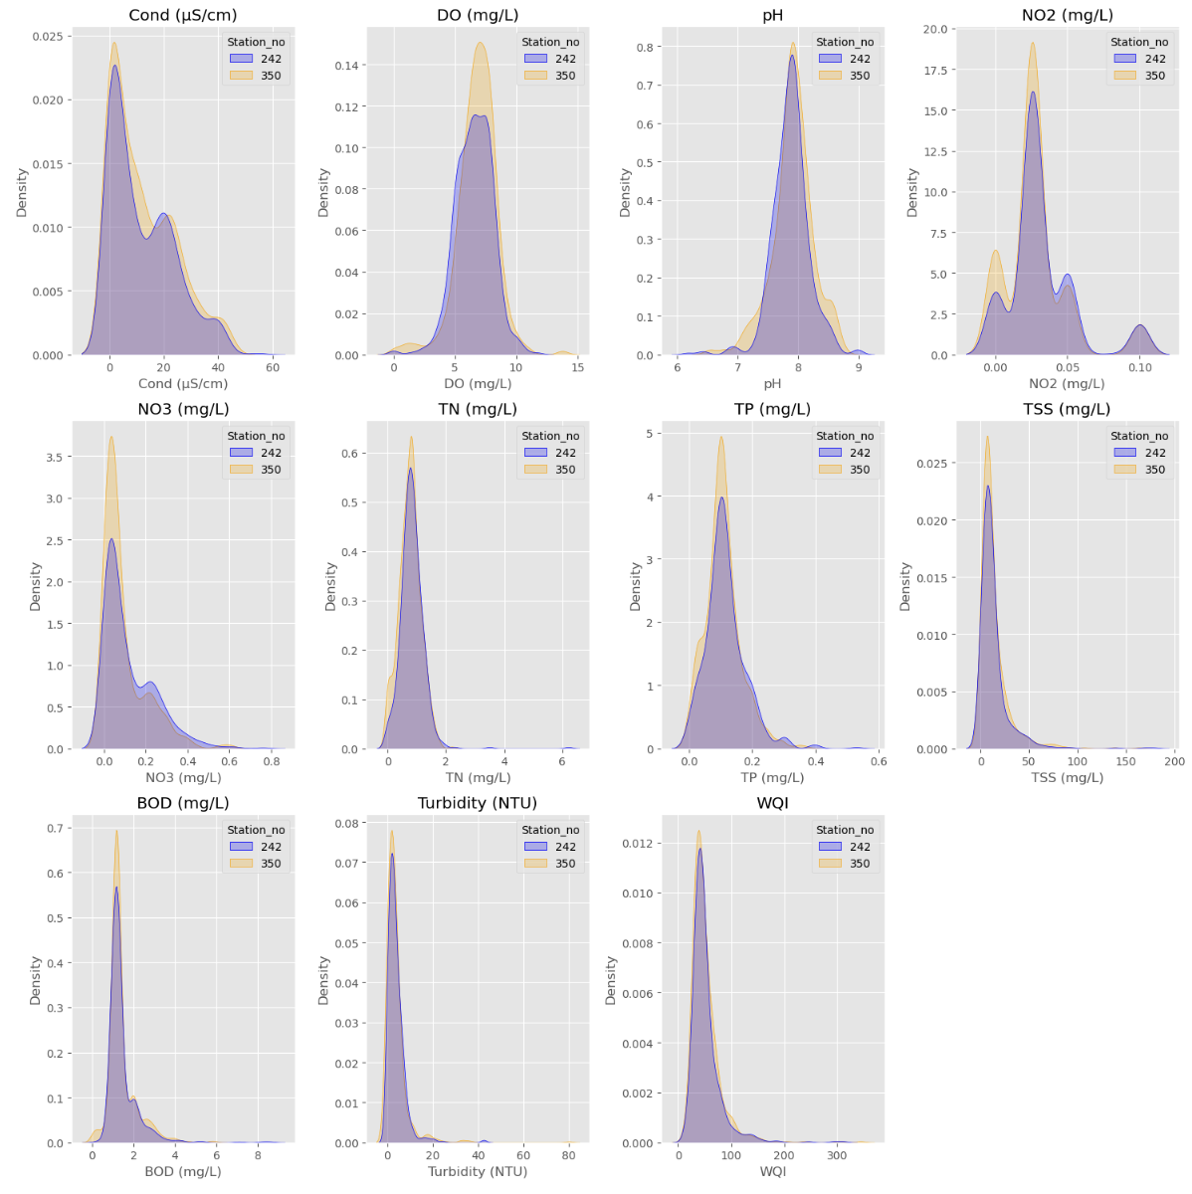
Exploratory Data Analysis (EDA)
WQI
Most data btw 35 – 56.
WQI values spanned from 12.5 – 343.
Mean value of WQI – 51.
Figure 3. KDE plots for numerical features for each station.

Slide 9
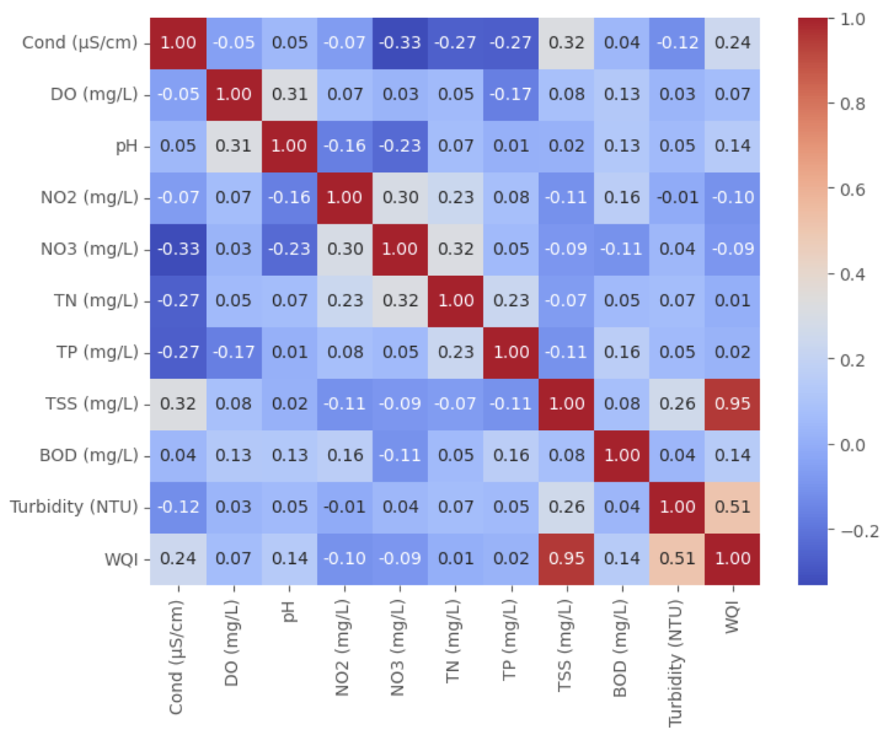
Exploratory Data Analysis (EDA)
WQI has a very strong positive correlation with TSS and a moderate positive correlation with Turbidity.
Figure 4. Correlation Heatmap of Numerical Features.

Slide 10
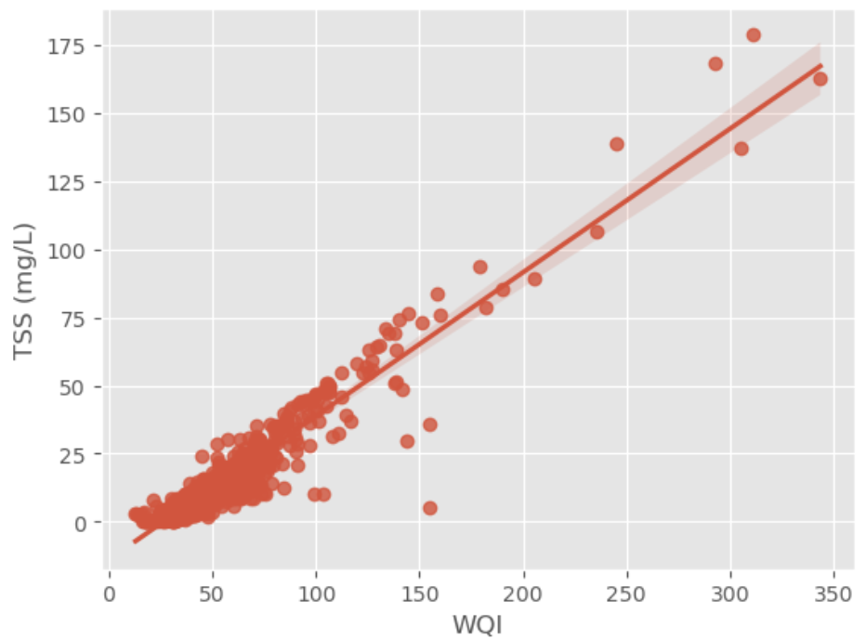
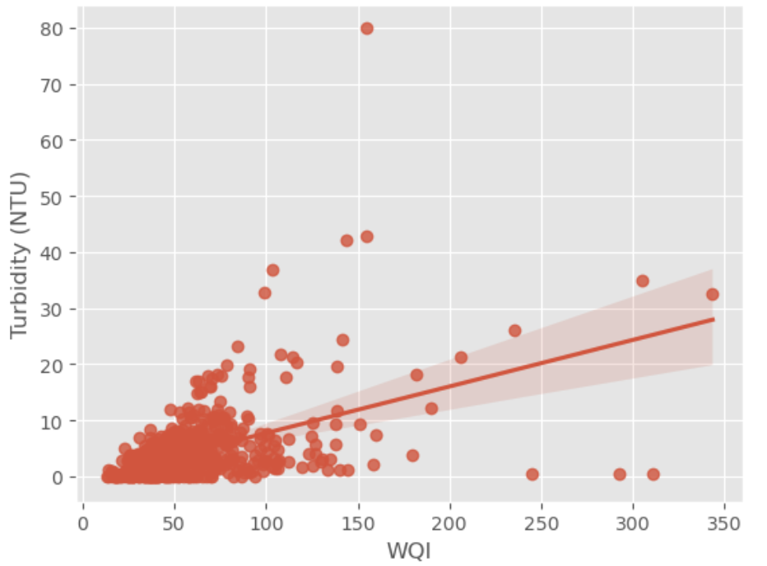
Exploratory Data Analysis (EDA)
Knowing the value of TSS and Turbidity can provide valuable information for predicting WQI.
Figure 5. Regression Plot of WQI vs TSS.
Figure 6. Regression Plot of WQI vs Turbidity.

Slide 11
Preprocessing and Training Data Development
Encoded 'Water Quality Classification' into binary columns.
Extracted 'Month' from 'Date' for seasonal analysis.
Split data into 80-20 ratio for training and testing.
Applied Power Transformation to address skewness and outliers.
Used MinMaxScaler to scale numerical features to range [0, 1].

Slide 12
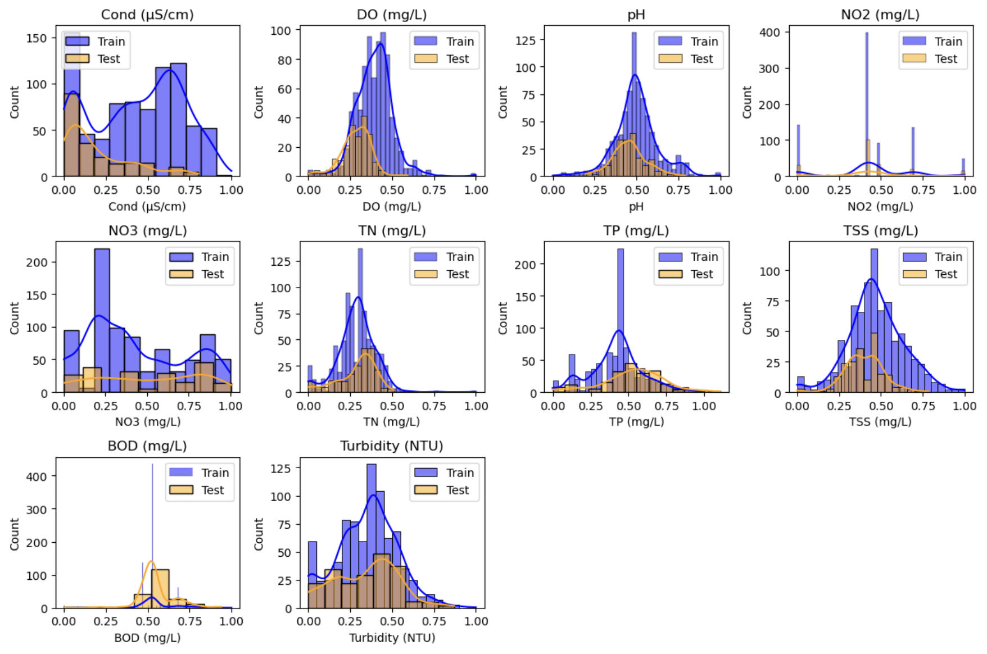
Preprocessing and Training Data Development
- distributions closer to a normal distribution
- consistent range between 0 and 1
Figure 7. Histograms of numerical features after scaling.

Slide 13
Modeling
Regression models: Linear Regression, Lasso Regression, Ridge Regression, Random Forest Regression, XGBoost Regression.
Evaluation metrics: R2 score, MSE, MAE.
Hyperparameter tuning: GridSearchCV
Random Forest: 'n_estimators': [100, 200, 300], 'max_depth': [None, 10, 20], 'min_samples_split': [2, 5, 10], 'min_samples_leaf': [1, 2, 4], 'max_features': ['sqrt', 'log2']
XGBoost: 'n_estimators': [100, 200, 300], 'max_depth': [3, 5, 7], 'learning_rate': [0.01, 0.05, 0.1]
Cross-validation: 3-fold, 5-fold, 7-fold, 10-fold.

Slide 14
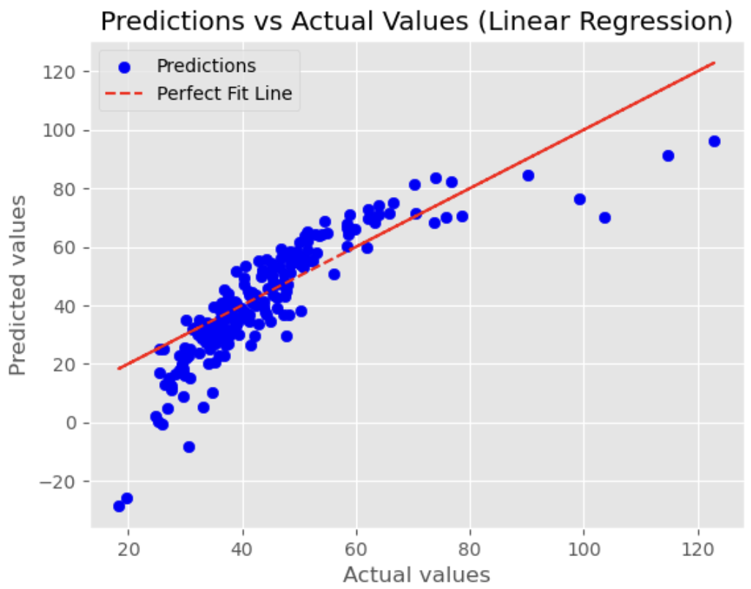
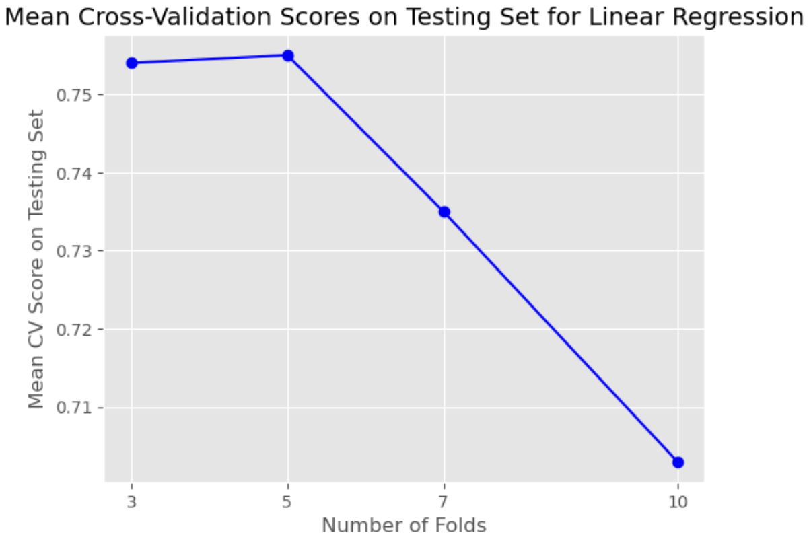
Modeling – Linear Regression
0.755
R2 = 0.48
MSE = 117.107
MAE = 8.069
Figure 8. Relationship between the predicted and actual values.
Figure 9. The cross-validation results.

Slide 15
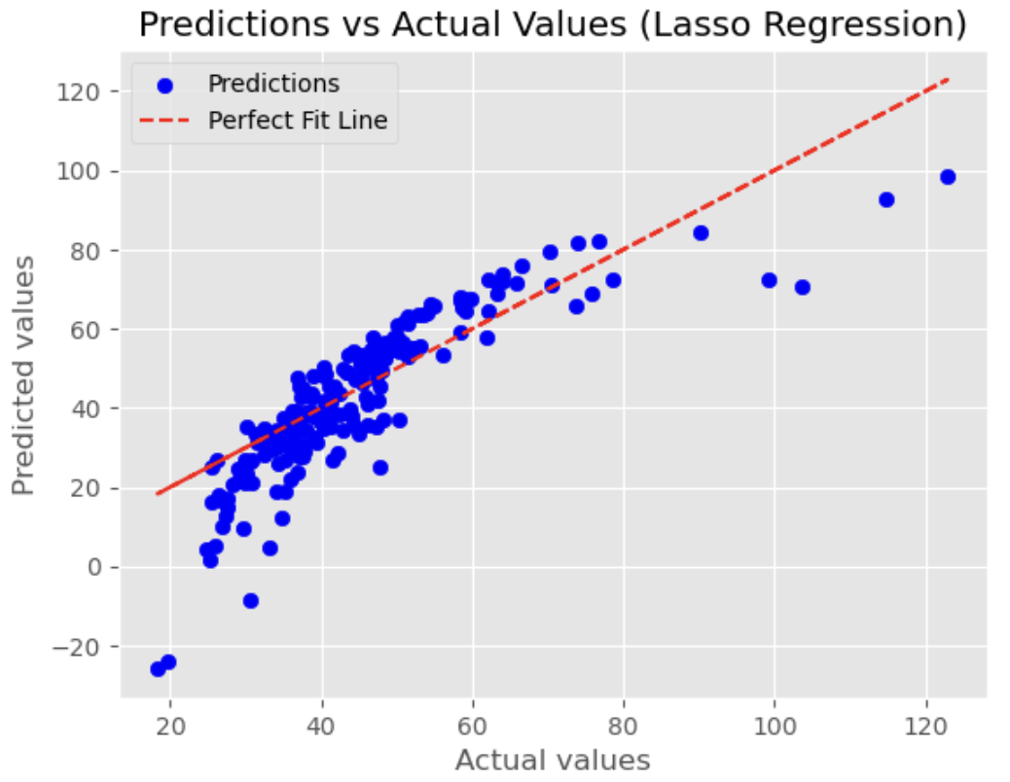
Modeling – Lasso Regression
R2 = 0.54
MSE = 103.36
MAE = 7.438
Figure 10. Relationship between the predicted and actual values

Slide 16
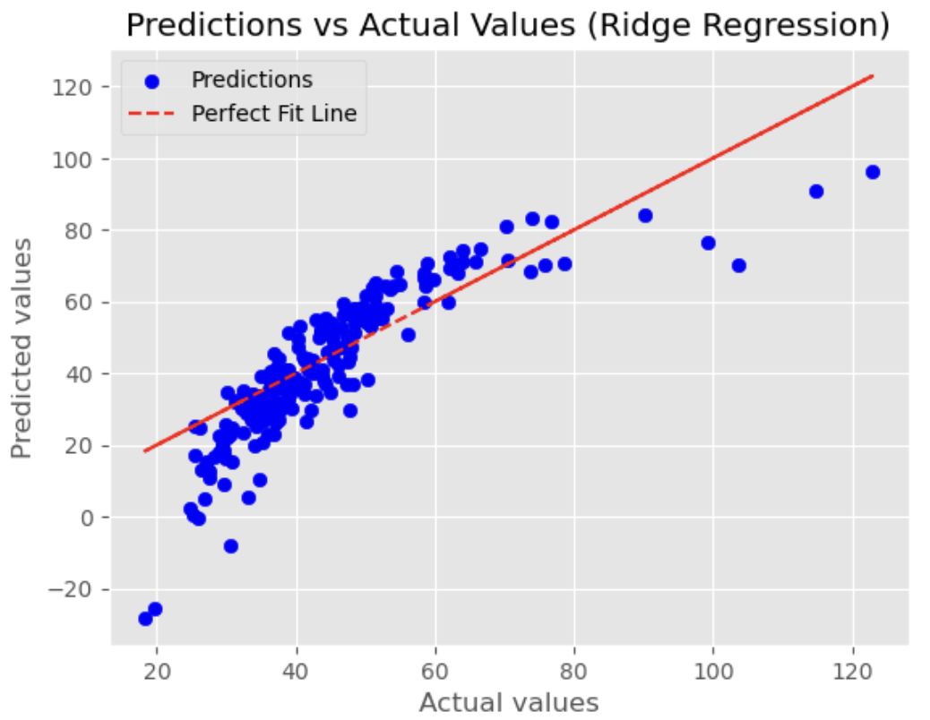
Modeling – Ridge Regression
R2 = 0.48
MSE = 116.024
MAE = 8.032
Figure 11. Relationship between the predicted and actual values

Slide 17
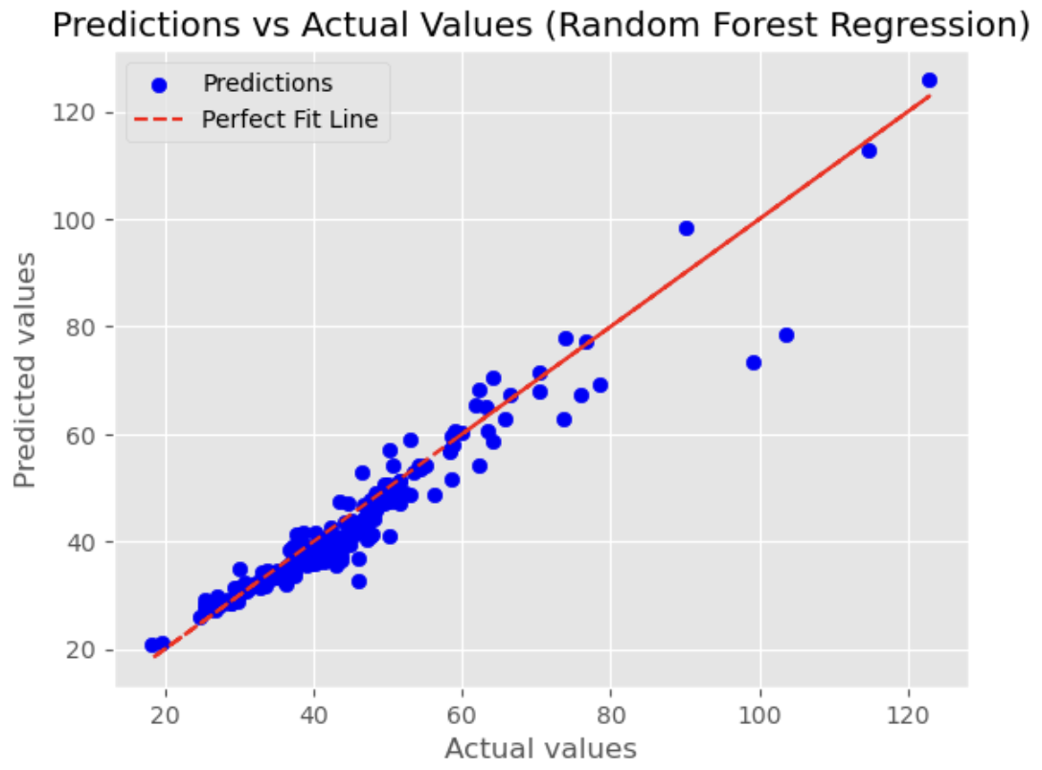
Modeling – Random Forest Regression
R2 = 0.923
MSE = 17.285
MAE = 2.665
Figure 12. Relationship between the predicted and actual values.

Slide 18
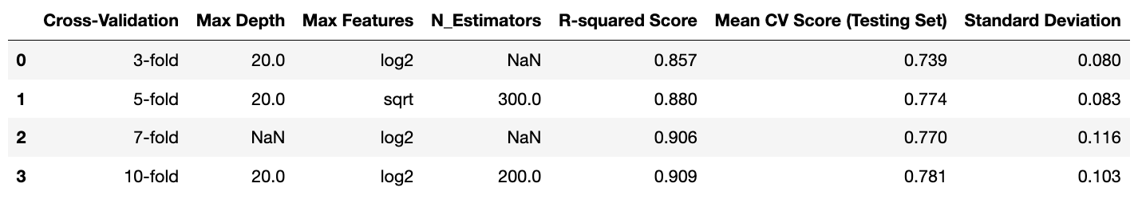
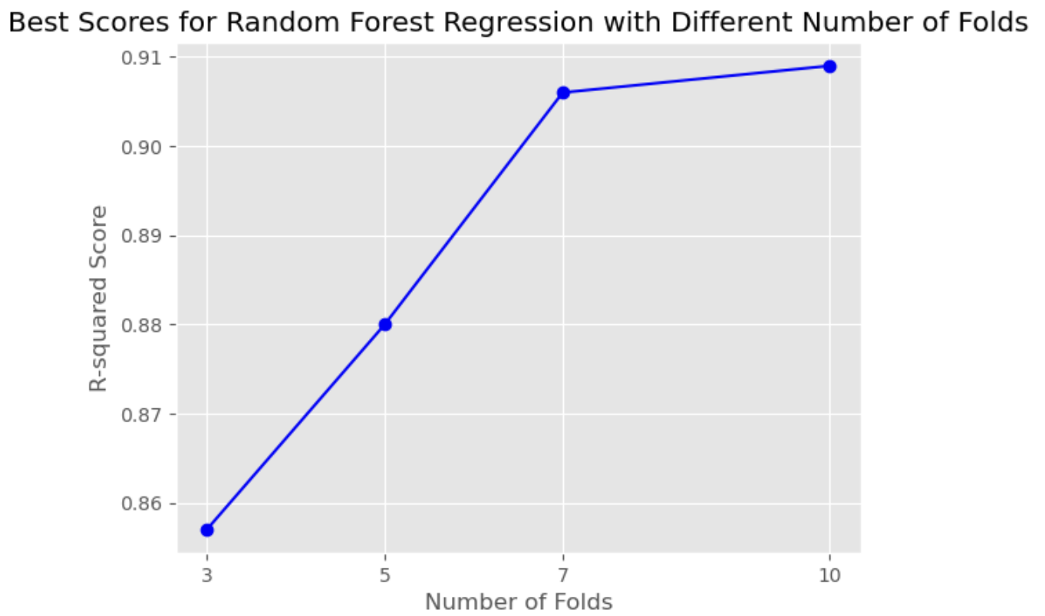
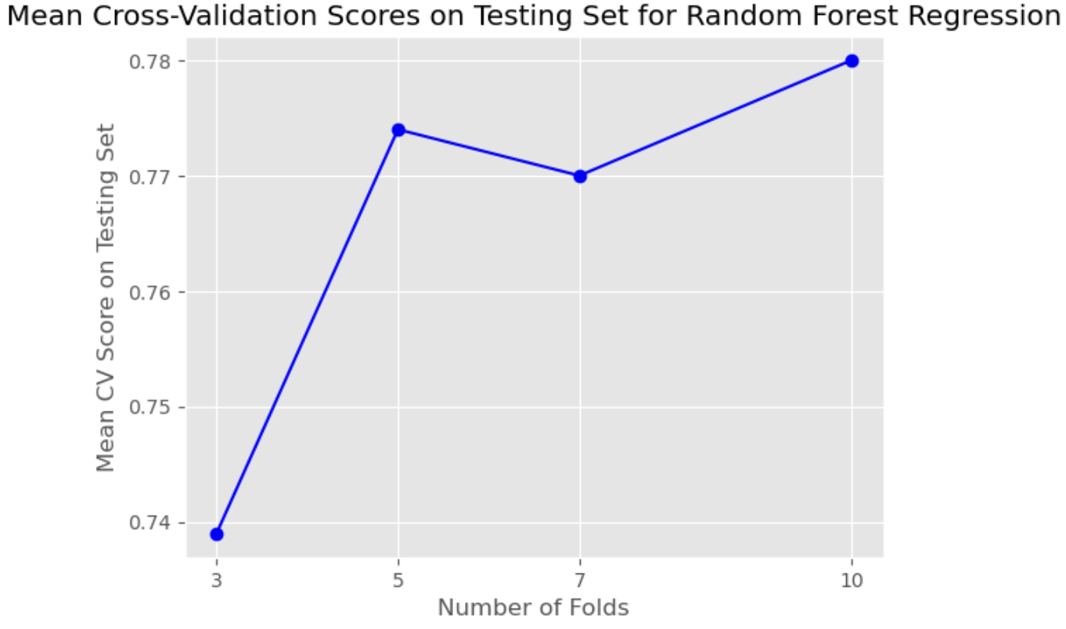
Modeling – Random Forest Regression
Table 1. Random Forest Model Cross-Validation Results.
R2 = 0.909
CV = 0.781
Figure 13. Best scores with different number of folds for the Random Forest model.
Figure 14. The mean cross-validation scores on testing set for the Random Forest Regression.

Slide 19
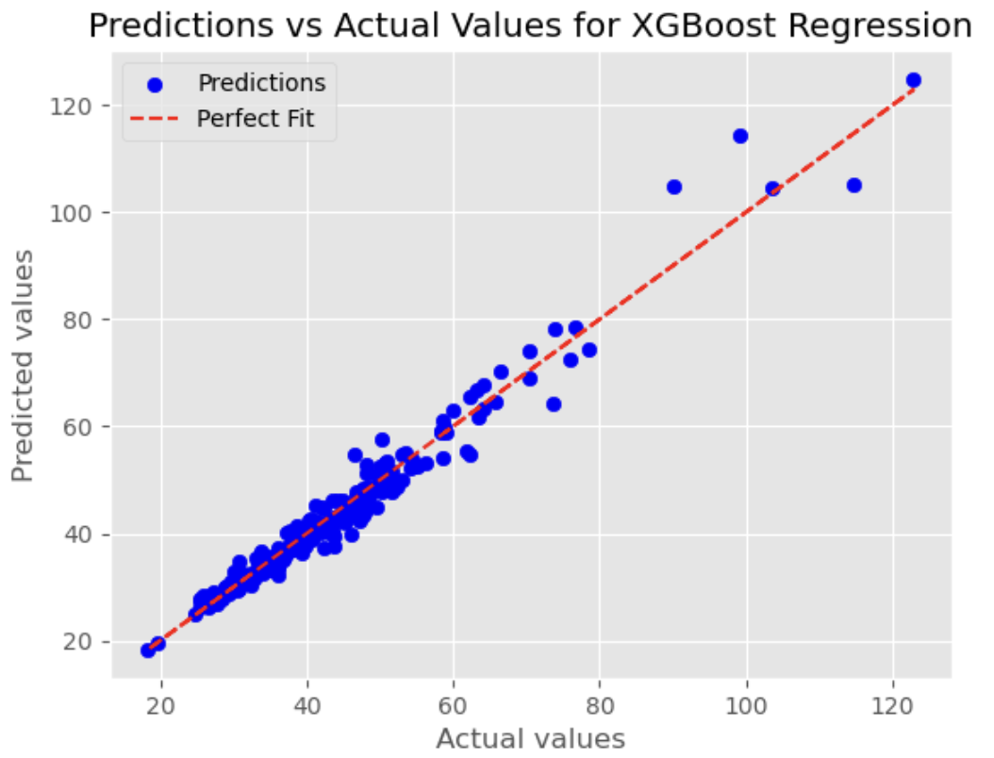
Modeling – Xgboost Regression
R2 = 0.962
MSE = 8.469
MAE = 2.008
Figure 15. Relationship between the predicted and actual values generated by the XGBoost Regression model.

Slide 20
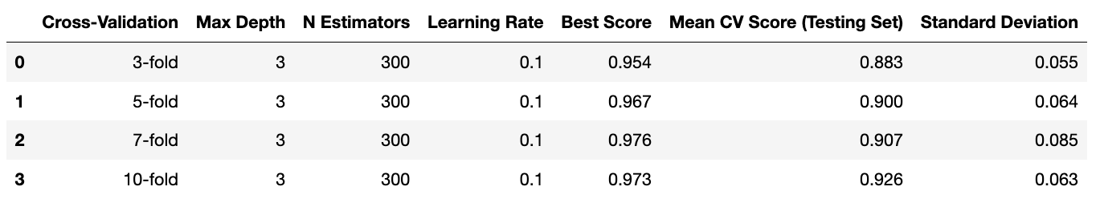
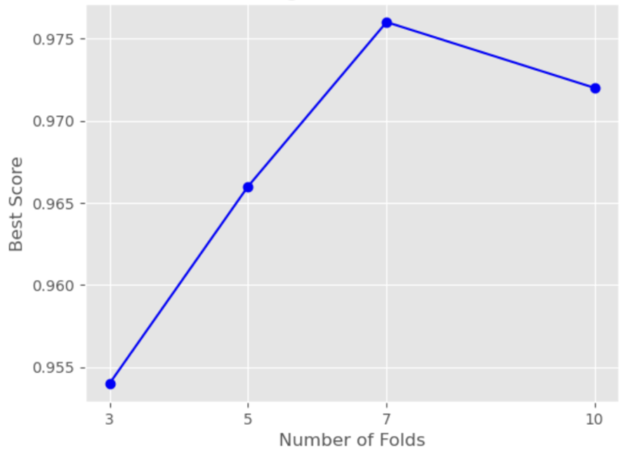
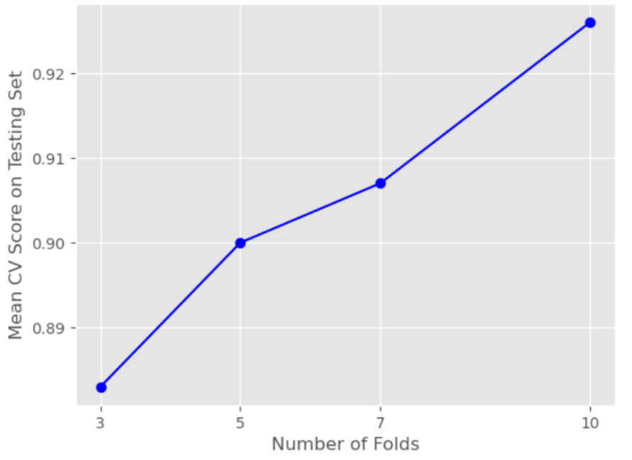
Modeling – XGboost Regression
Table 2. XGBoost Model Cross-Validation Results.
CV = 0.781
R2 = 0.973
Figure 16. Best scores with different number of folds for the XGBoost model.
Figure 17. Mean cross-validation scores on the testing set for XGBoost regression model.

Slide 21
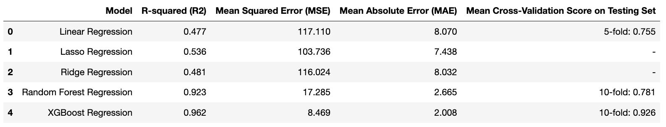
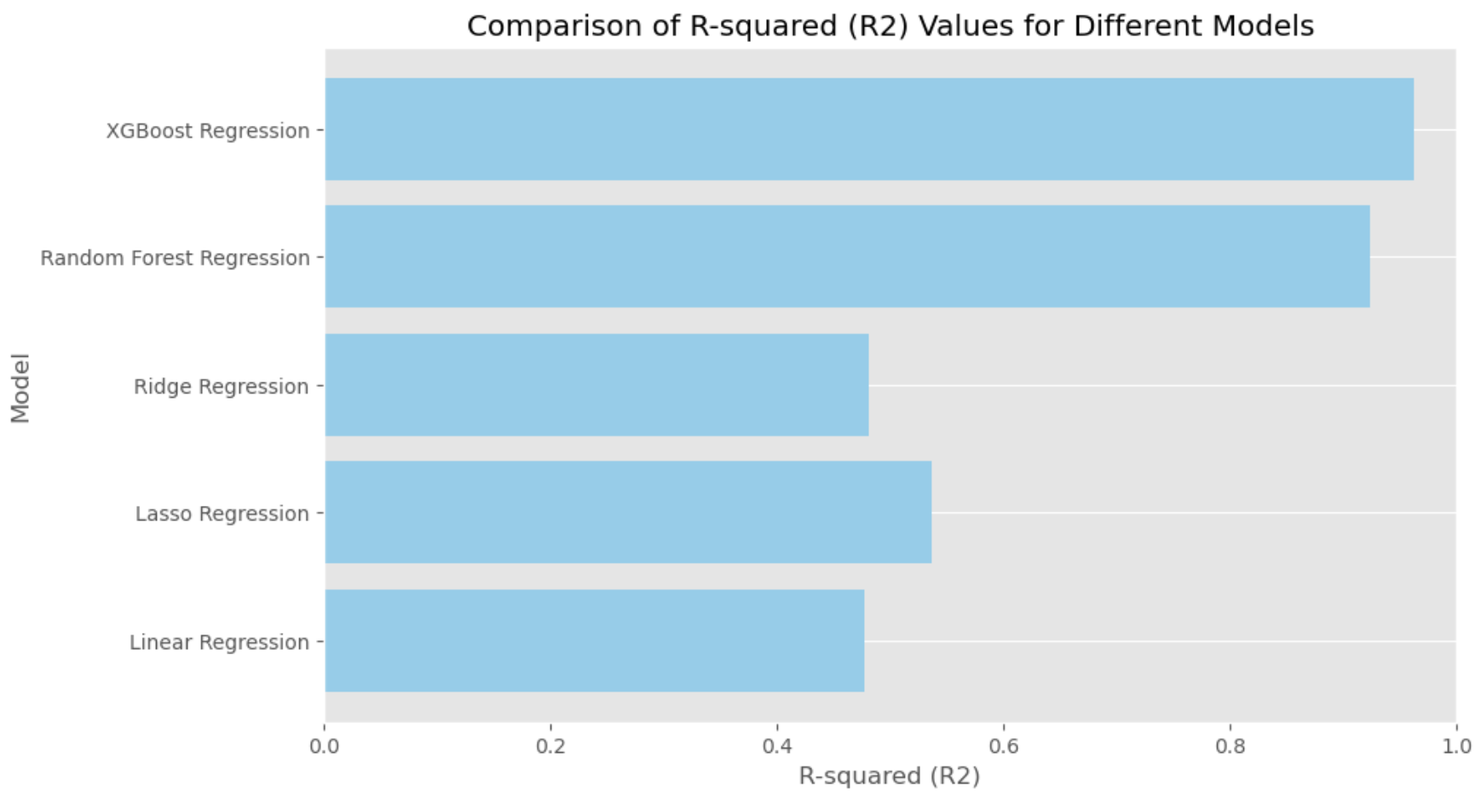
Results
Table 3. Comparison of regression models.
Figure 18. Comparison of R2 values for different models.

Slide 22
Conclusion
Top-Performing Model: XGBoost Regression achieved R2 value of 0.962 with lowest MSE and MAE.
Importance of Selection: Highlighted the significance of feature selection, model choice, and evaluation metrics for accurate prediction.
Insights and Limitations: Provided insights into key factors influencing water quality prediction, acknowledging study limitations and potential areas for improvement.

Slide 23
Future Work
Feature Engineering: Enhance predictive models by exploring additional factors.
Seasonal and Long-Term Trends: Investigate temporal patterns in water quality.
Spatial Analysis: Identify areas of concern using GIS tools.
Deep Learning Methods: Improve predictive accuracy with neural networks.
Validation through Field Studies: Ensure practical usefulness and reliability.

Slide 24

Questions?

